Slide 1
Component Programming
Islam Qudah
i.al-qudah@cse.unsw.edu.au

Slide 2
What is Software Component?[1]
A software package, web service or module that encapsulates related functions.
Its reusable
Has an interface
Substitutable: Replaceable components

Slide 3
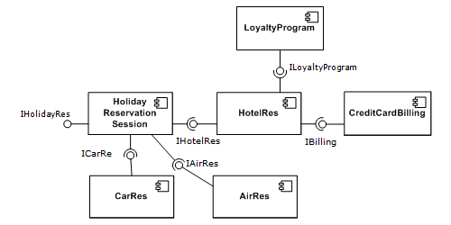
Example
Figure1 – Holiday System Components Example [1]

Slide 4
Cont. [2]
Components programming delivers multiple binaries, which combined form an application/system
If you change one component , you don’t need to recompile the whole application.
Existing clients don’t need to recompile/redeploy anything
New requirements can be delivered as new components, without having to change the existing components

Slide 5
Examples of software components
DOS Batch file
Linux/Unix Shell Script
C# DLL file
JAR File

Slide 6
DOS Batch File as a Component Example
Input : CSV File and filter parameters
Invoke Perl Program passing the parameters
Filter through the csv file based on input parameters
Generate output csv file

Slide 7
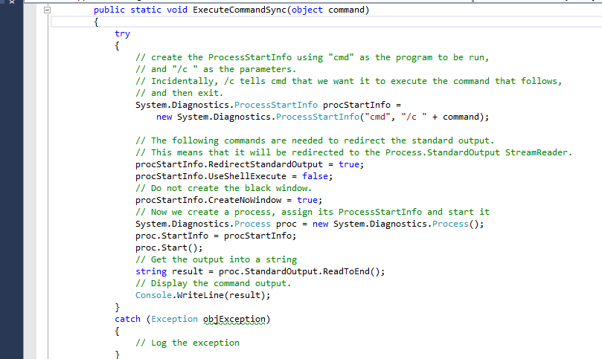
Execute Batch file From C# [4]
Invoke DOS batch file from C#

Slide 8
Component-Oriented Versus Object-Oriented Programming [2]
Object Oriented Programming focuses on the relationship between classes, which combined make a large binary executable
Component Oriented Programming focuses on producing modules that work independently and don’t require the client to know the inner details of these modules
Every Class is an independent component
Notes:
Decomposing Sophisticated systems into components that could be invoked independently
Every class in a component programming architecture can compiled into a component

Slide 9
DLL File Example[3]
Create C# Classes
Generate DLL file
Generate EXE file
Run the EXE file

Slide 10
Create C# Classes
// File: Add.cs
namespace UtilityMethods
{
public class AddClass
{
public static long Add(long i, long j)
{
return (i + j);
}
}
}

Slide 11
// File: Mult.cs
namespace UtilityMethods
{
public class MultiplyClass
{
public static long Multiply(long x, long y)
{
return (x * y);
}
}
}

Slide 12
// File: TestCode.cs
using UtilityMethods;
class TestCode
{
static void Main(string[] args)
{
System.Console.WriteLine("Calling methods from MathLibrary.DLL:");
if (args.Length != 2)
{
System.Console.WriteLine("Usage: TestCode <num1> <num2>");

Slide 13
return;
}
long num1 = long.Parse(args[0]);
long num2 = long.Parse(args[1]);
}
long sum = AddClass.Add(num1, num2);
long product = MultiplyClass.Multiply(num1, num2);
System.Console.WriteLine("{0} + {1} = {2}", num1, num2, sum);
System.Console.WriteLine("{0} * {1} = {2}", num1, num2, product);
}

Slide 14
Generate DLL file and Generate EXE file
"C:\Windows\Microsoft.NET\Framework\v2.0.50727\csc" /target:library /out:MathLibrary.DLL Add.cs Mult.cs
"C:\Windows\Microsoft.NET\Framework\v2.0.50727\csc" /out:RunUtility.exe /reference:MathLibrary.DLL TestCode.cs
Run the utility:
RunUtility.exe 10 20

Slide 15
References
[1] http://en.wikipedia.org/wiki/Component-based_software_engineering
[2] http://oreilly.com/catalog/pnetcomp/chapter/ch01.pdf
[3] http://msdn.microsoft.com/en-us/library/3707x96z.aspx
[4] http://www.codeproject.com/Articles/25983/How-to-Execute-a-Command-in-C
[5] http://stackoverflow.com/questions/6660512/how-to-get-csc-exe-path
[6] http://en.kioskea.net/faq/8721-converting-a-bat-into-exe
[7] http://stackoverflow.com/questions/26551/how-to-pass-command-line-parameters-in-batch-file

